Slide 1
HTML
Lab 16: Basic HTML (HTML List)

Slide 2


Welcome to HTML Class

Slide 3

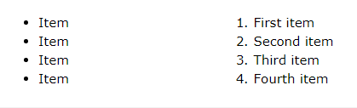
HTML List
Three ways for specifying lists of information.
UL-Unordered List
OL-Ordered List
DL-Definition List

Slide 4
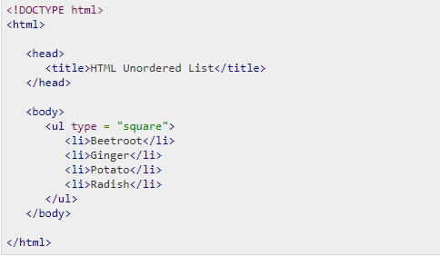
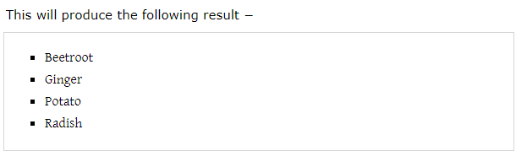
Unordered List
A collection of related items that have NO special order or sequence.
This list is created by using HTML <ul> tag

Slide 5
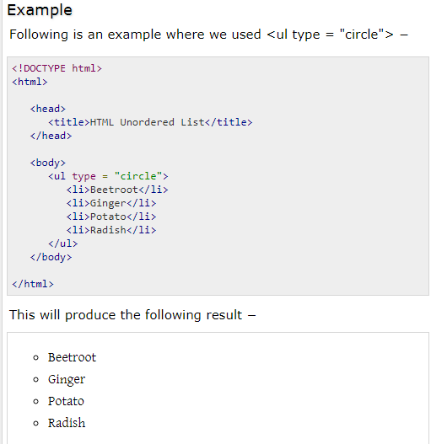
Unordered List

Slide 6
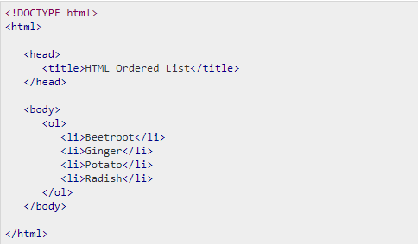
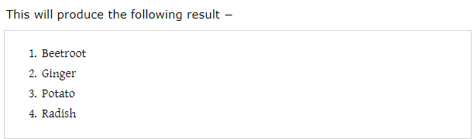
Ordered List
A collection of related items that have special order or sequence.
This list is created by using HTML <ol> tag

Slide 7
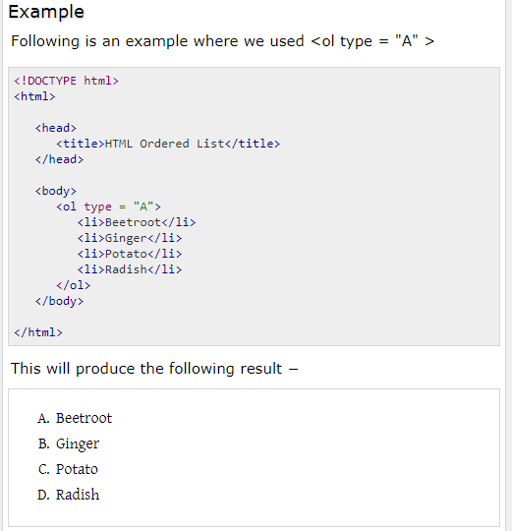
Ordered List

Slide 8

Today’s learning:
HTML Unordered list
HTML Ordered List
Thank You!

